Slide 1

Electromagnetic Field Coupling: Frequency-Domain Solutions
Farhad Rachidi
Swiss Federal Institute of Technology (EPFL)
EMC Laboratory
Farhad.Rachidi@epfl.ch
http://emc.epfl.ch

Slide 2
Frequency Domain Solution
Classical Telegrapher’s Equations
The voltage wave equation is found by taking the derivative of the first Telegrapher’s equation with respect to line position (x) :
and then substituting in the second equation
  To yield the voltage wave equation
𝛾²
A similar procedure is used to derive the current wave equation

Slide 3
Frequency Domain Solution
Classical Telegrapher’s Equations
Thus, the telegrapher's equations can be manipulated into two uncoupled wave equations for the line voltage and current:
where 𝛾 is a complex, frequency-dependent propagation constant of the line defined as
  with Z'(ω) = R' + jωL' and Y'(ω) = G' + jωC' .

Slide 4
Frequency Domain Solution
Classical Telegrapher’s Equations
The solutions to the wave equations for the voltage V is in the form of exponential functions:
  and the same is true for the current, I
  Note that the e ^{–𝛾 x} terms correspond to positive traveling waves on the line
And the e ^{+γx} terms correspond to negative traveling waves

Slide 5
Frequency Domain Solution
Classical Telegrapher’s Equations
The voltage and current traveling wave components are related by the line parameters
  Consider the positive traveling waves:
  Substituting V⁺ into the first Telegrapher equation
  gives
This is the characteristic impedance of the transmission line, Z_{c}

Slide 6
Frequency Domain Solution
Classical Telegrapher’s Equations
Complex propagation constant
Characteristic impedance
Positive voltage wave:
Phase velocity:
Different frequencies in the spectrum of a pulse propagate at different speeds and suffer different attentuation: Dispersion effect
Attenuation constant
Phase constant
Input pulse
Lossy line
Output pulse

Slide 7
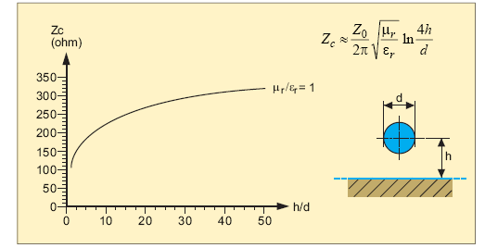
Frequency Domain Solution
Characteristic Impedance of Common TLs

Slide 8
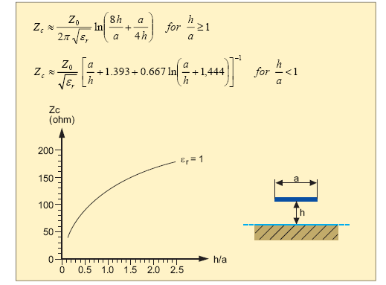
Frequency Domain Solution
Characteristic Impedance of Common TLs

Slide 9
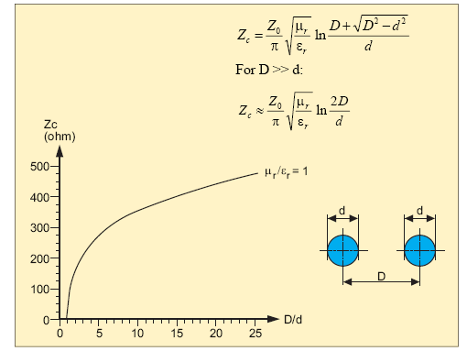
Frequency Domain Solution
Characteristic Impedance of Common TLs

Slide 10
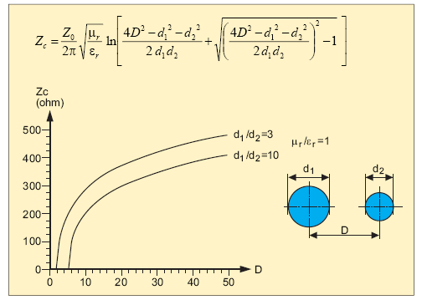
Frequency Domain Solution
Characteristic Impedance of Common TLs

Slide 11
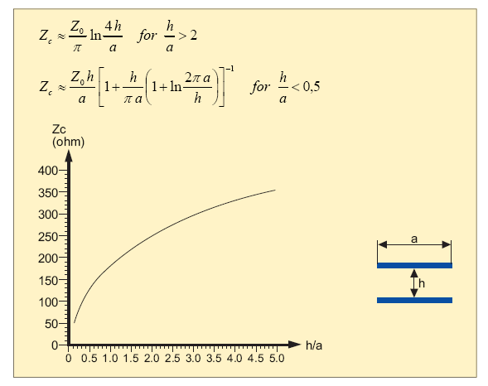
Frequency Domain Solution
Characteristic Impedance of Common TLs

Slide 12
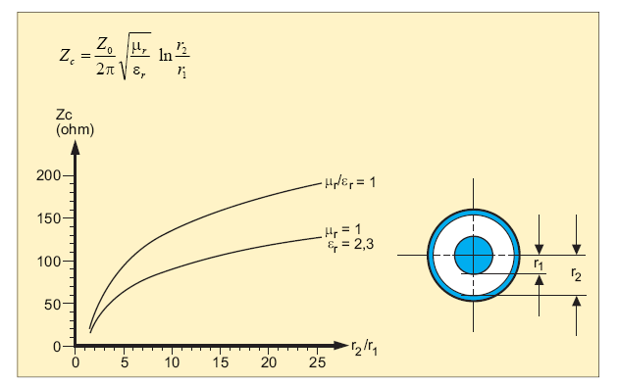
Frequency Domain Solution
Characteristic Impedance of Common TLs

Slide 13
Frequency Domain Solution
Infinite line excited by a series voltage source
Consider an infinite transmission line excited by a series voltage source V_{o} at location x_{s}
  The voltage source launches
  voltage and current waves in
  both + and – directions
Away from the source, the voltage and current is described by the previously derived traveling wave solutions
Because the line is infinite, there are no reflections from the ends
  Thru, for x > x_{s}, only positive traveling waves exist
  and for x < x_{s}, the waves are only negative traveling.

Slide 14
Frequency Domain Solution
Infinite line excited by a series voltage source
For this line, the responses are
expressed as
  where A and B must be determined from the excitation conditions.
At x = x_{s}, the current must be continuous
  I(x_{s}⁺) = I(x_{s}–)
And the voltage is discontinuous by the source voltage
  V(x_{s}⁺) = V(x_{s}–)+ V_{o}

Slide 15
Frequency Domain Solution
Infinite line excited by a series voltage source
From the current condition I(x_{s}⁺) = I(x_{s}–) we obtain
From the voltage condition V(x_{s}⁺) = V(x_{s}–)+ V_{o} we get
Thus, the total solution is
  V(x) = (V_{o}/2)e ^{- 𝛾(x- x}_{s}⁾ for x > x_{s}
  V(x) = (-V_{o}/2)e ^{𝛾(x-x}_{s}⁾ for x < x_{s}
  and
  I(x) = (V_{o}/2Z_{c} )e ^{- 𝛾(x-x}_{s}⁾ for x > x_{s}
  I(x) = (V_{o}/2Z_{c} )e ^{𝛾(x-x}_{s}⁾ for x < x_{s}

Slide 16
Frequency Domain Solution
Infinite line excited by a parallel currentsource
The same analysis procedure
can be used for a shunt current
source I_{o} exciting the line
The expressions for the line voltage and current are
  V(x) = (I_{o}Z_{c}/2) e ^{-𝛾(x-x}_{s}⁾ for x > x_{s}
  V(x) = (I_{o}Z_{c}/2) e ^{𝛾(x-x}_{s}⁾ for x < x_{s}
  and
  I(x) = (I_{o}/2)e ^{- 𝛾(x-x}_{s}⁾ for x > x_{s}
  I(x) = (–I_{o}/2)e ^{𝛾(x-x}_{s}⁾ for x < x_{s}
I
o
Reference conductor
x
x
s

Slide 17
Frequency Domain Solutions
Finite line excited by a series voltage/shunt current source
Consider a line of length L with termination impedances Z₁ and Z₂ at the ends:
  For x < x_{s}, both positive and
  negative traveling waves exist
    due to reflections at the load
Same is true for x > x_{s}
On each section of line, 2 sets of
coefficients A & B are needed
to represent the responses
  Thus, a total of 4 unknowns are required:
Line is excited by both a series voltage source V_{o} and a shunt current source, I_{o} at x = x_{s}

Slide 18
Frequency Domain Solutions
Finite line excited by a series voltage/shunt current source
The 4 unknown coefficients are determined from 4 conditions imposed on the solution:
  At the source at x_{s}, the line current is discontinuous by the amount I_{o} ➔ I(x_{s}⁺) = I(x_{s}–)+ I_{o}
  At the source, the line voltage is discontinuous by the amount
  V_{o} ➔ V(x_{s}⁺) = V(x_{s}–)+ V_{o}
  At the ends of the line at x = 0 and L, the total line voltage and current are related by the load
  impedance Z_{L} as
Note that the change of sign occurs here due to the definition of the direction of the “line current”

Slide 19
Frequency Domain Solutions
Finite line excited by a series voltage/shunt current source
Voltage Reflection Coefficient:
Realistic lines are not infinite in length. Consider the case of a finite line extending from x = 0 to x = L as shown in Figure below. At the end of a line there is an impedance element Z_{L}, which is assumed to be a complex valued quantity relating the total load voltage V_{L} to the load current I_{L}. A traveling wave propagating in the positive direction and incident on the load will create a reflected wave which propagates in the negative direction away from the load. Due to this reflection, at any point on the line there will be a combination of both positive and negative propagating waves. It is useful to define the ratio of the reflected voltage wave at any point along the line to the incident voltage wave as a general reflection coefficient as
ρ(x) =
=

Slide 20
Frequency Domain Solutions
Finite line excited by a series voltage/shunt current source
Voltage Reflection Coefficient (cont’d):
The voltage and current at any point on the line can now be expressed in terms of the voltage reflection coefficient as
The ratio of line voltage to current defines an impedance quantity which is the input impedance of the line at the location x looking towards the load. This is expressed as
At the load, the input impedance is just the load impedance
V(x) = ae^{-𝛾x} + be ^{𝛾 x} = ae^{- 𝛾 x} + ρ(x)ae^{- 𝛾 x} = ae^{- 𝛾 x} [1 + ρ(x)]
I(x) = Y_{c}(ae^{- 𝛾 x} - be ^{𝛾 x}) = Y_{c}(ae^{- 𝛾 x} - ρ (x)ae^{- 𝛾 x}) = Y_{c}ae^{- 𝛾 x} [1 - ρ (x)]

Slide 21
Frequency Domain Solutions
Finite line excited by a series voltage/shunt current source
And from this expression, the reflection coefficient at the load can be determined to be
If Z_{L} = Z_{c}, ρ = 0 and there is no reflected wave
  We say that the line is “matched”
For an open circuit load, Z_{L} = ∞ and ρ= 1
For a short circuit load, Z_{L} = 0 and ρ= –1
Characteristic impedance of the transmission line
Load impedance

Slide 22
Frequency Domain Solutions
Line excited by a series voltage/shunt current source
Using the source and load
termination conditions, the
4 coefficients can be
evaluated to yield the line
voltage and current expressions for x > x_{s}:
V(x) = [(e^{γxs} - ρ₁e^{–γxs})V_{o} + (e^{γxs} + ρ₁e^{–γxs})Z_{c}I_{o}]
I(x) = [(e^{γxs} - ρ₁e^{–γxs})V_{o} + (e^{γxs} + ρ₁e^{–γxs})Z_{c}I_{o}]
Also observe that the excitation terms are identical for the current and the voltage
Voltage and current source terms
The only difference here is the impedance term and the sign change!
Resonance term
Observation location on line, with x > x_{s}
Notes:
Source location, x_{s}

Slide 23
Frequency Domain Solutions
Line excited by a series voltage/shunt current source
Similar expressions exist
for the line voltage and
current for x < x_{s}:

Slide 24
Frequency Domain Solutions
Line excited by a series voltage/shunt current source
Responses at line terminals:

Slide 25
Frequency Domain Solutions
Line excited by a series voltage/shunt current source

Slide 26

Frequency Domain Solutions
Line excited by a series voltage/shunt current source

Slide 27
Frequency Domain Solutions
Line excited by a series voltage/shunt current source
BLT equations

Slide 28
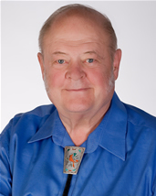
Frequency Domain Solutions
Line excited by a series voltage/shunt current source
Dr. Carl Baum (1940-2010)
BLT equations

Slide 29
Frequency Domain Solutions
Line excited by a series voltage/shunt current source
?
Dr. T.K. Liu
BLT equations

Slide 30

Frequency Domain Solutions
Line excited by a series voltage/shunt current source
Dr. Fred M. Tesche
BLT equations

Slide 31
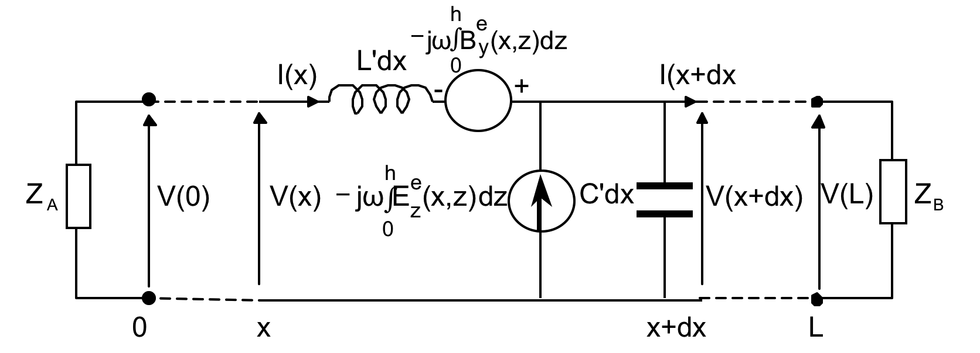
Frequency Domain Solutions
Line excited by a distributed voltage/shunt current source
where:

Slide 32
Two-Conductor TL Solutions
Example of Load Response
Consider the case of a 30 m long line with a vertically polarized plane wave field with ψ = 60° and ϕ= 0°
Load impedances are Z_{c}/2 (not matched)
  We want to compute the current at the Z₂ load impedance

Slide 33
Two-Conductor TL Solutions
Example of Load Response
Consider a unit amplitude transient, double exponential waveform for the incident E-field
Transient response for the load current is obtained from a standard FFT method

Slide 34
Two-Conductor TL Solutions
Example of Load Response
The shape of the induced current waveform can be explained by looking at the times of arrival of various wave contributions

Slide 35
Two-Conductor TL Solutions
Example of Load Response
The shape of the induced current waveform can be explained by looking at the times of arrival of various wave contributions
Waveform first strikes the line at t = 0

Slide 36
Two-Conductor TL Solutions
Example of Load Response
The shape of the induced current waveform can be explained by looking at the times of arrival of various wave contributions
First response occurs at t = t₁

Slide 37
Two-Conductor TL Solutions
Example of Load Response
After t = t₁, the effects of the distributed sources on the line arrive, giving rise to a continuous response that looks similar to the incident field
The shape of the induced current waveform can be explained by looking at the times of arrival of various wave contributions

Slide 38
Two-Conductor TL Solutions
Example of Load Response
The shape of the induced current waveform can be explained by looking at the times of arrival of various wave contributions
Effect from end of line arrives at t = t₂ and partially cancels with the response.

Slide 39
Two-Conductor TL Solutions
Example of Load Response
The shape of the induced current waveform can be explained by looking at the times of arrival of various wave contributions

Slide 40
Two-Conductor TL Solutions
Example of Load Response
The shape of the induced current waveform can be explained by looking at the times of arrival of various wave contributions

Slide 41
References and Further Reading
[1] F.M. Tesche, M. Ianoz, T. Karlsson, Emc Analysis Methods and Computational Models, Wiley, 1997.
[2] C.R. Paul, Transmission Lines in Digital and Analog Electronic Systems, Wiley, 2010.
[3] F. Rachidi, A Review of Field-to-Transmission Line Coupling Models with Special Emphasis to Lightning-Induced Voltages, IEEE Transactions on Electromagnetic Compatibility, Vol. 54, No. 4, pp. 898 - 911, 2012.

